Slide 1



Enhancing AWS CI/CD Pipelines: Automated Security Testing with Snyk

Slide 2
Problem Domain
Traditional development practices often defer security considerations to later stages, making software susceptible to cyber threats.
Overlooking early security testing in the software development lifecycle exposes organizations to increased risks.
Integrating security testing into the CI/CD pipeline is essential for proactive vulnerability identification and mitigation, thereby enhancing software security.

Slide 3
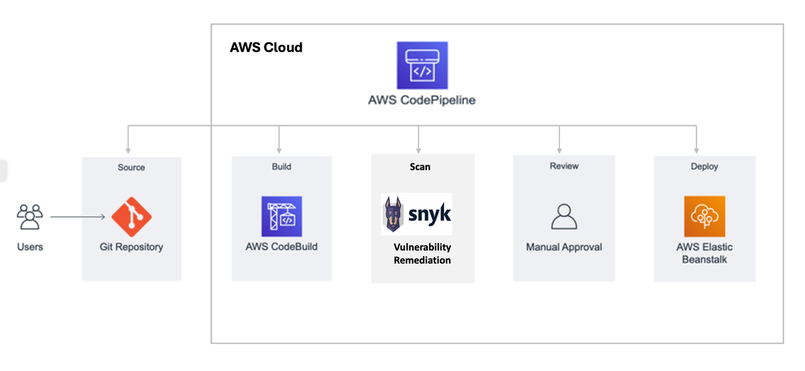
Initial Design
Build a CI/CD pipeline
Integrate security testing (Snyk) into the CI/CD pipeline
AWS Elastic Beanstalk Node.js Sample App

Slide 4
Issues encountered
Connecting the GitHub repository
Give an option for GitHub v1 that uses OAuth or GitHub v2 that creates a Connection
V1 has access to any repository you are part of; V2 has access to repositories you created
Using an app that would not build properly
Initially we planned to use a basic Todo-list web application implemented with Flask
The scanning tools and build pipeline were configured for a Java application
Snyk integration misconfiguration
Certain files in the repository weren’t getting scanned for vulnerabilities
We had to ensure that Snyk wasn’t just looking at changes from the previous commit but scanning the entire repository

Slide 5
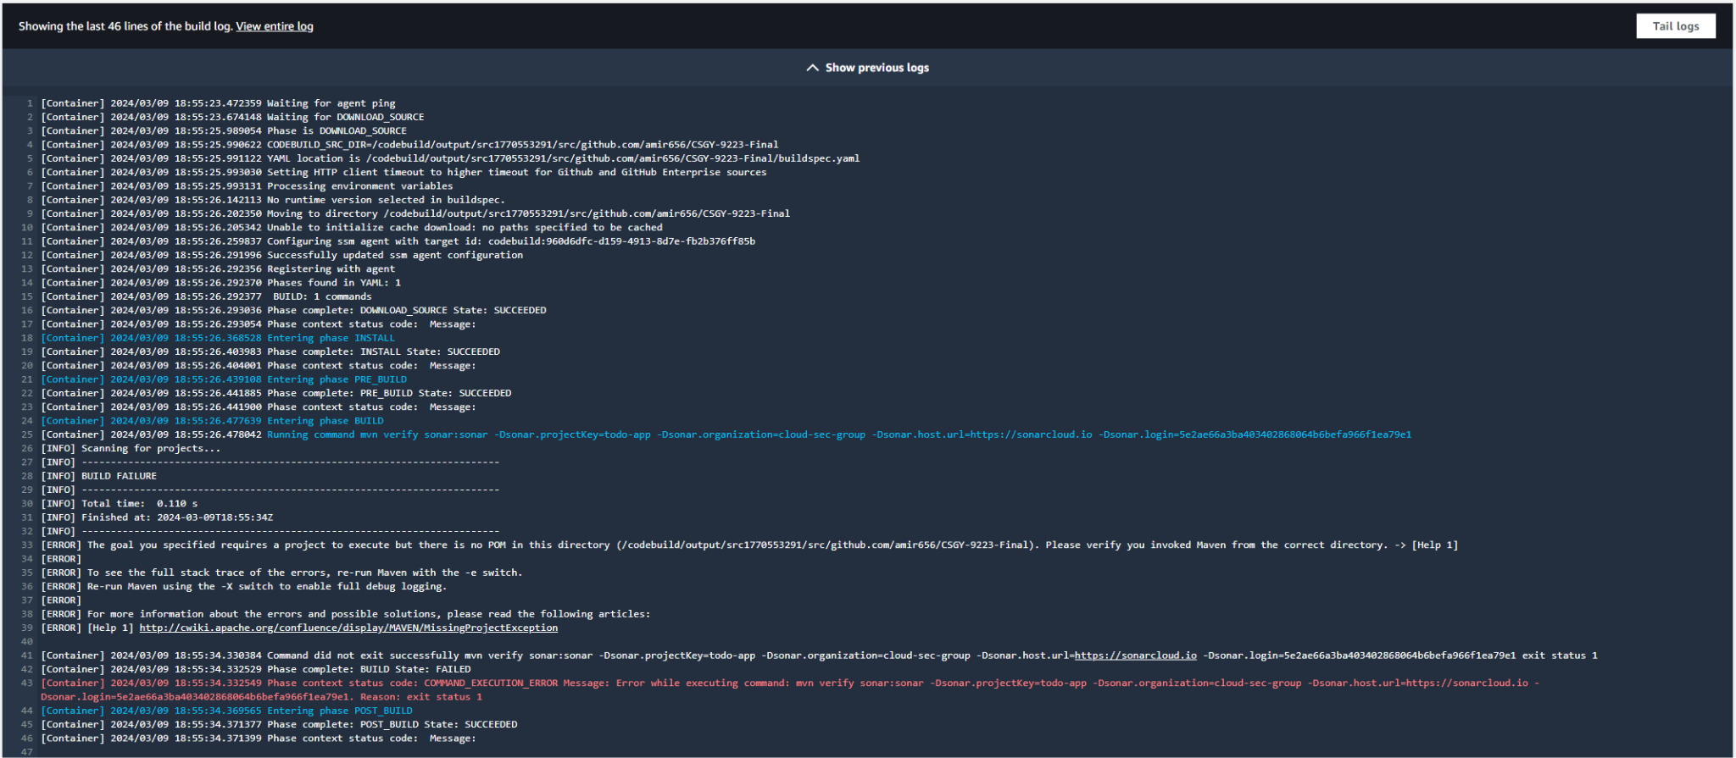

Slide 6
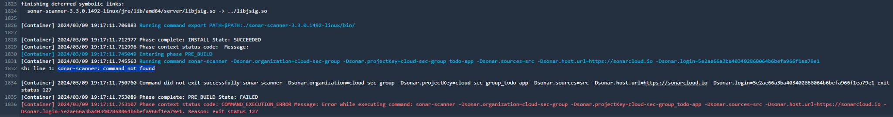
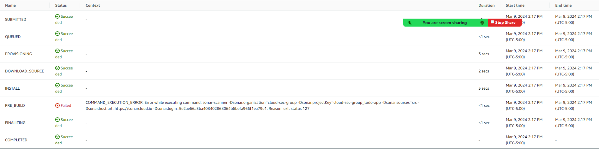

Slide 7
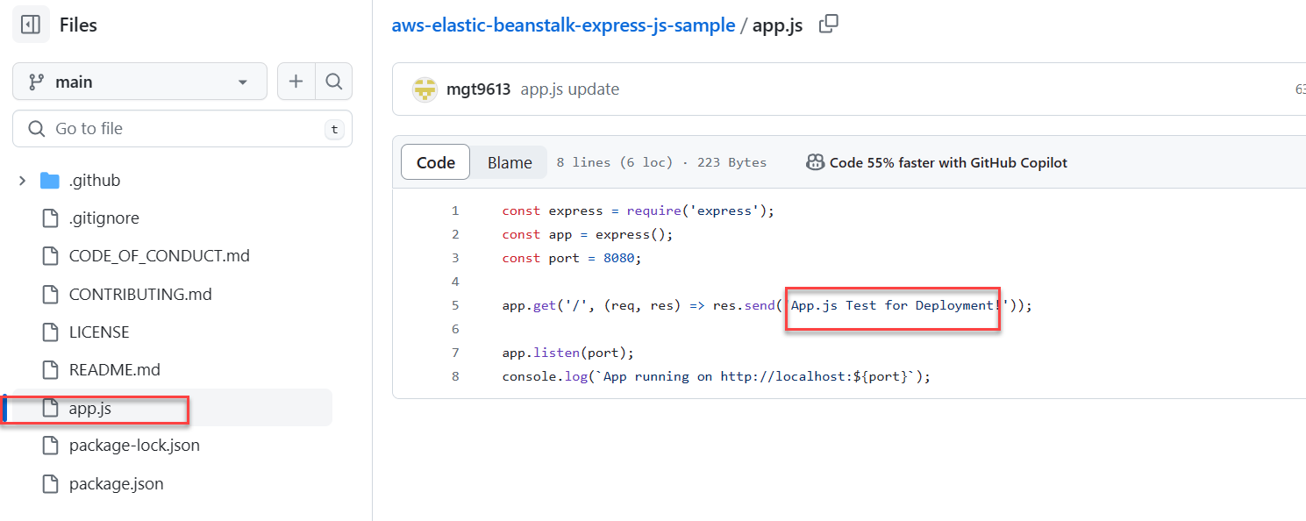
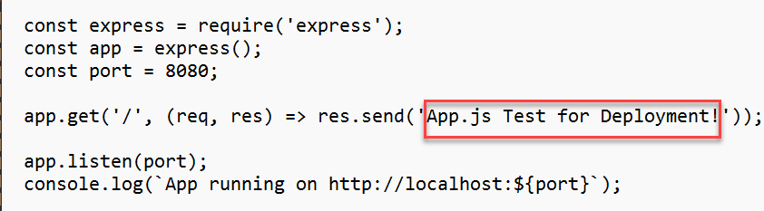
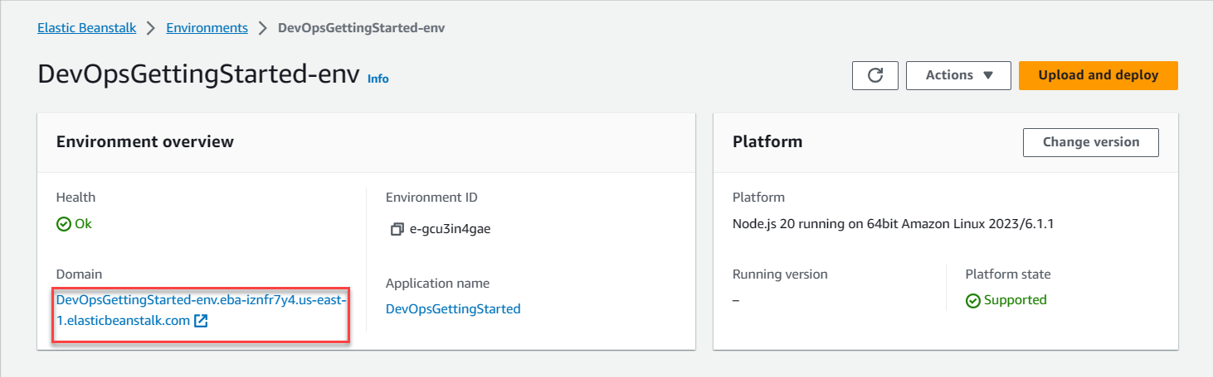
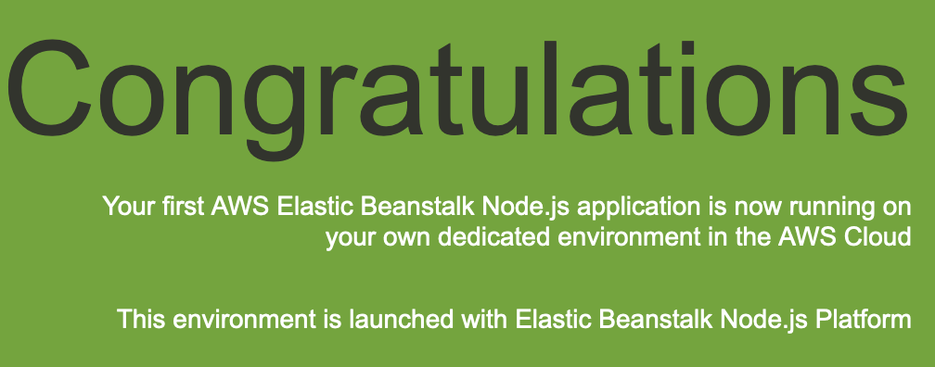
Final design
Fork the starter repo
Implementation: Setup Git Repository
Push a change to the new repo
Implementation: Deploy Web App
AWS Elastic Beanstalk App

Slide 8
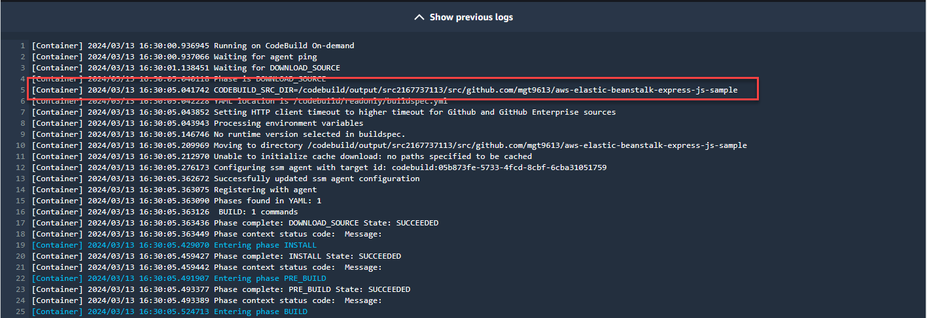
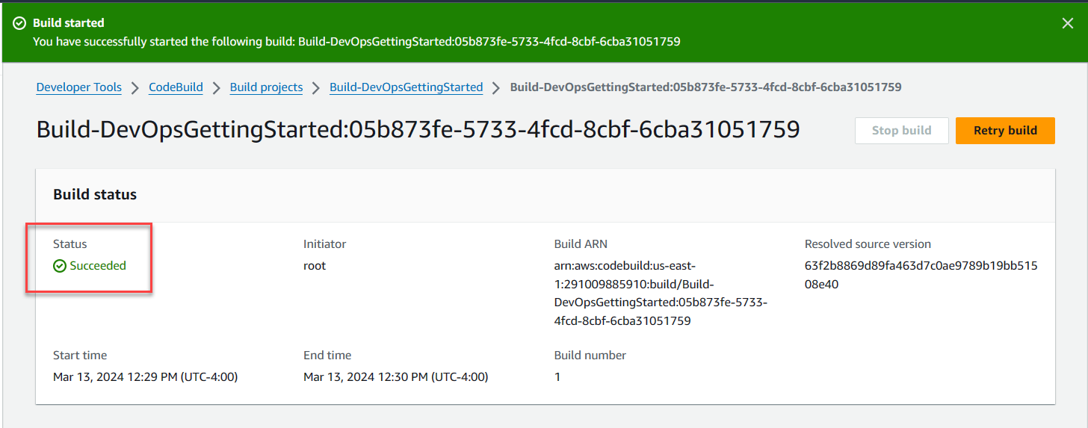
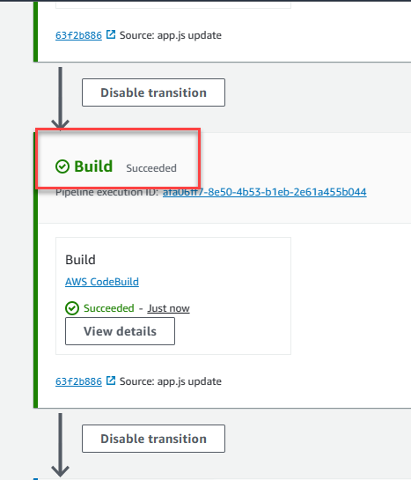
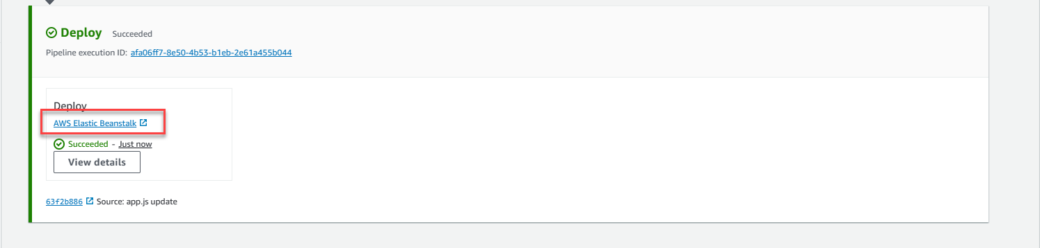
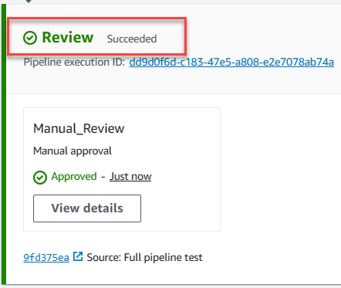
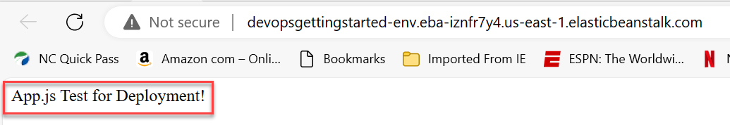
Implementation: Create AWS CodeBuild Project
Implementation: Create and execute a delivery pipeline

Slide 9
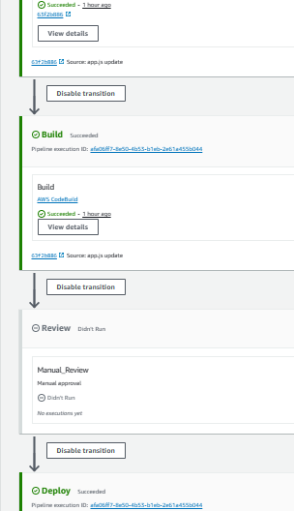
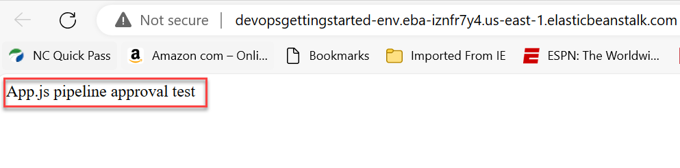
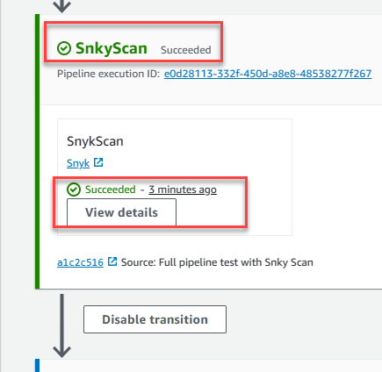
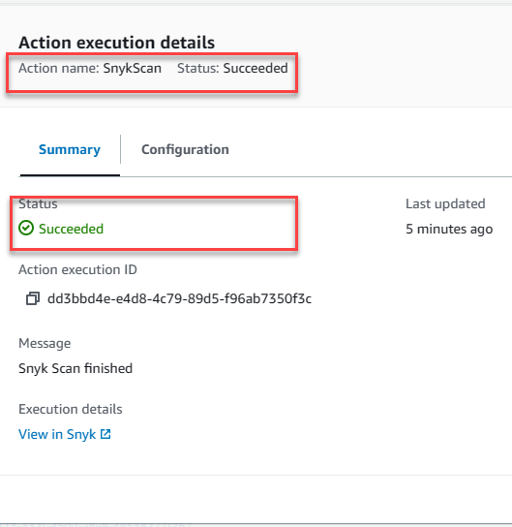
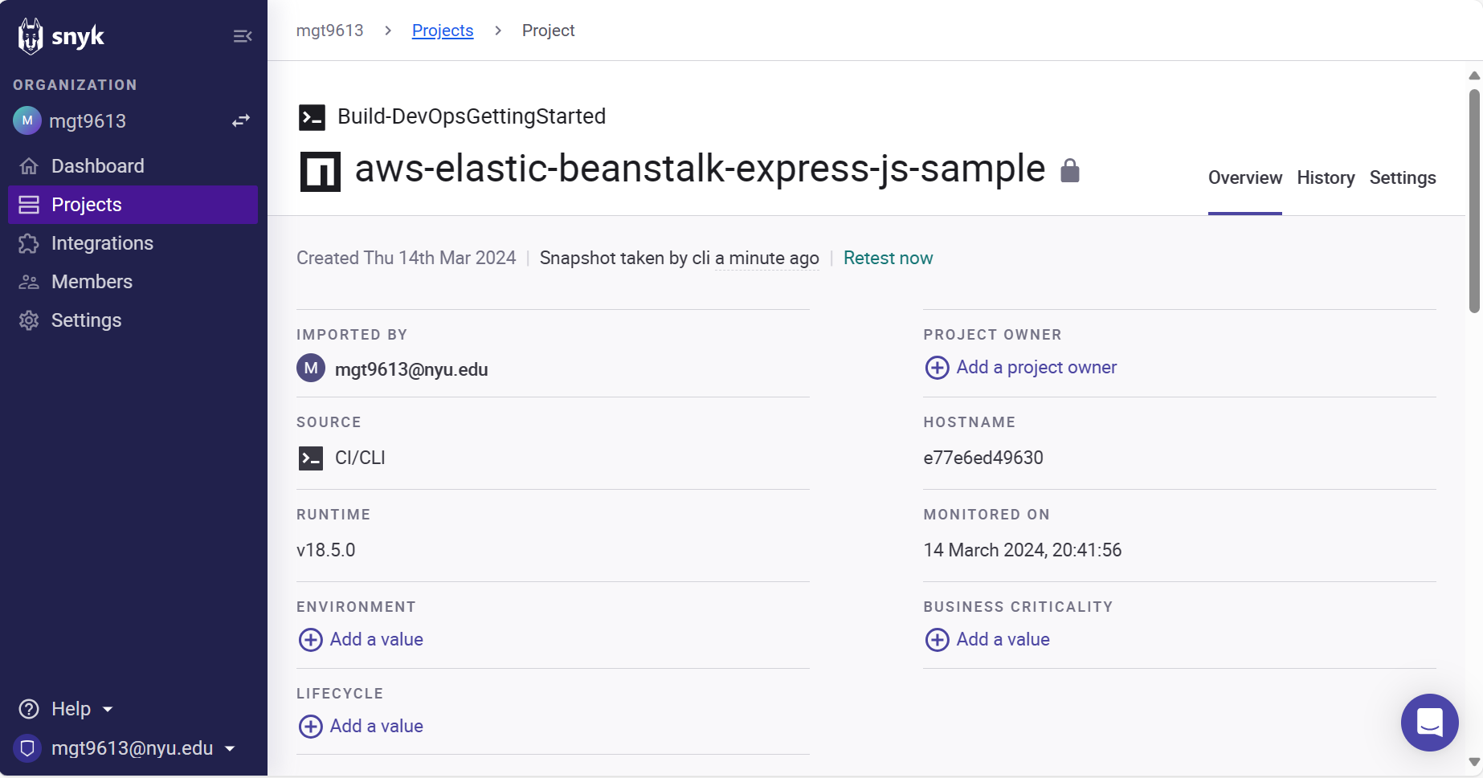
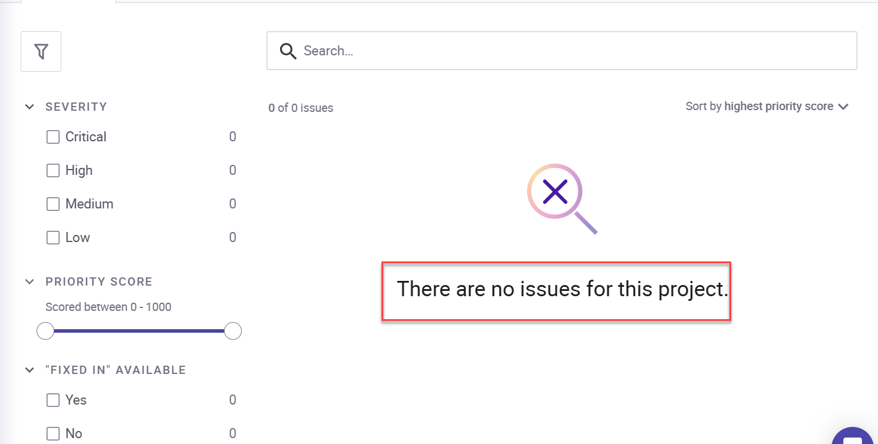

Implementation: Finalize pipeline and test
Implementation: AWS CodePipeline Snyk integration

Slide 10
Demo of the Pipeline

Slide 11
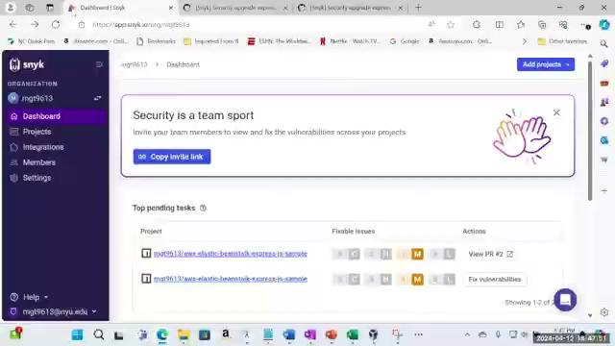

Slide 12
Lessons learned/Future work
Measure twice, cut once
If we had spent more time researching and planning, we could have avoided some back and forth over which app to select and which security scanner to implement
Future work
Add new steps to the pipeline
Detect new classes of vulnerabilities
Auto-triage vulns to security team / product team
Additional features
Integrate with containerization platforms (e.g., Docker, Kubernetes)
Automate compliance checks

Slide 13
Conclusion
The best time to add safeguards is today
A CI/CD pipeline is the foundation for a robust, efficient, and secure software delivery process. It helps identifying potential vulnerabilities before they are out in the wild.
Security is everyone’s responsibility. By integrating a CI/CD pipeline step you help everyone get involved in each step of the software development lifecycle

